Slide 1

Repair agency Final Project Java external classes
trainer: Maksym Liashenko
student: Vitalii Hrushyn

Slide 2
Task variant # 3
Repair Agency System. The Customer can create an order for repair of the product. The Manager can accept the application specifying the price, or reject it, specifying the reason. The Workman can execute the application, which has been accepted by the Manager. Customer can leave a Feedback about the performed work.

Slide 3
Used technologies and apis
JDBC API, MySQL
Junit, Mockito
Log4J
Servlet, JSP, JSTL
System supports internalization.
Sessions and filters are used in application.
Pagination, Transaction, Authorization and Authentication are implemented.

Slide 4
Project architecture
Model: DAO, entities, services
View: JSP, JSTL (including custom tag)
Controller: Servlet, Commands, filters, listener
Patterns: Abstract Factory, Factory Method, Command, Flyweight, MVC, DAO

Slide 5
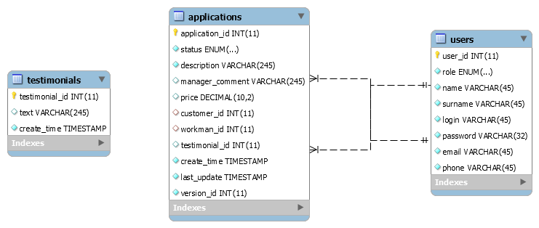
DATA base eer model

Slide 6
Application features
System protects against double login: previous existing session terminated when user enter system from another frame.
There is protection against concurrent editing of applications (entity)

Slide 7
thank you for paying attention

